Slide 1
AI in Biomedical Research Bootcamp – Morning Session
Patrick McNeely, PhD
21 Aug 2026

Slide 2
Today’s Outline
Overview of Artificial Intelligence (AI) and Machine Learning (ML)
Terminal basics (a crash course)
Data: What are we learning from?
Python programming
Hands-on: Building a model to make classification predictions

Slide 3
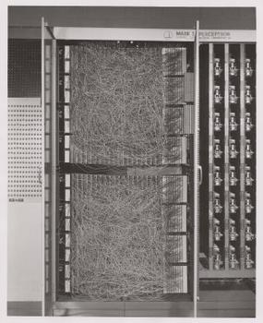
Artificial Intelligence and Machine Learning
Machine Learning
A sub-topic within AI
Introduces algorithms that allow machines to “learn”
Fundamentally, about trying to codify human learning processes
May be based on mathematical relationships, physical intuition, or other human intuitions
Statistics
Information theory
Dimensional separability
Others…
Mark I Perceptron
https://en.wikipedia.org/wiki/Perceptron

Slide 4
Artificial Intelligence and Machine Learning
Formats informed by human resources & knowledge
ML Engineers must first outline how to ask a question …
…and what format they expect an answer to have
Algorithm structure evolved with success and failure of instances
Hidden Markov Models, Probability Graphs, Support Vector Machines , Decision Trees, Perceptrons, Artificial Neural Networks, and many others

Slide 5
Terminal Navigation & Use
Basic navigation commands
Change directory: cd
Show the present working directory: pwd
List files and directories on a path: ls [-lahS]
Move or rename a file/folder: mv
Copy a file or folder: cp [-R]
File & folder management commands
Make a new directory: mkdir [-p]
Remove a file or directory: rm [-r][-f] / rmdir
Show all folders and files, with nice formatting: tree
Find a file or directory: find
Resource management commands
Check available memory: free [-h]
Check available disk space: df [-h]
Whole-system view: top/htop
Current location disk usage: du [-hs]/ncdu

Slide 6
Terminal Navigation & Use
Environment commands
Source an environment file in shell: source
Show current environment settings: printenv
Important variable: $PATH (often, export PATH=$PATH:/new/program)
Program management commands
Find program on $PATH by name: which
Show or create a program shortcut: alias
update-alternatives [--config]
System commands
Install or manage software: apt[-get] (WSL/Ubuntu), brew (MacOS), dnf (Rocky)
Software manuals: man

Slide 7
Today’s Outline
Overview of Artificial Intelligence (AI) and Machine Learning (ML)
Terminal basics (a crash course)
Data: What are we learning from?
Python programming
Hands-on: Building a model to make classification predictions

Slide 8
Data: What to Reason Over?
Data can be anything humans are interested in
Led to fragmentation of the field into subdomains
In Biomedical Research, what might we be interested in?
Health records
*-omics (genomics, exomics, metagenomics, glycomics, proteomics, etc.)
Histology, pathology reports
Wetlab experiments & collated results
Images
Others…?

Slide 9
Data: What to Reason Over?
Data must be organized into categories and types
Data categories then guide how machine learning may be applied
Data may be structured or unstructured
Data categories may include things like:
Age, Demographics, HbA1c concentration, …
Others…
Data types may include
Decimals, integers, ordinal categories (‘small’, ‘medium’, ‘large’), unordered factors (‘green’, ‘blue’, ‘red’)
Others…

Slide 10
Data: How to Manage?
Attempt to model human reasoning
What constitutes “young” vs “old”?
What about “high” HbA1c vs “normal”?
Algorithm development across the board
Statistics
Linear algebra, calculus, etc.
Image processing
Edge detection
Feature detection
Language processing
Entity detection
Pattern recognition
Others …?

Slide 11
Today’s Outline
Overview of Artificial Intelligence (AI) and Machine Learning (ML)
Terminal basics (a crash course)
Data: What are we learning from?
Python programming
Hands-on: Building a model to make classification predictions

Slide 12
Python Programming
Why choose Python
An interpreted language
Built to emphasize readability, ease of learning
Single-threaded: intuitive order-of-operations
Has matured into a state-of-the-art powerhouse
Mature ecosystem of developers
Free, open-source development ecosystem

Slide 13
Python Programming
Atomic “Types”
Immutable vs mutable
Strings
Numbers (float, int, complex)
Boolean (bool / True, False)
Built-in types
Lists (arrays in other languages)
Dictionaries (hashmaps)
Sets (unordered lists of unique values)
….many others
Variables
Declared and set simultaneously
Not protected – common developer trap!

Slide 14
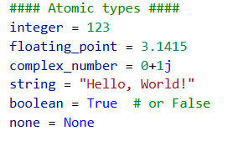
Python Programming
Atomic “Types”
Immutable vs mutable
Strings
Numbers (float, int, complex)
Boolean (bool / True, False)
Built-in types
Lists (arrays in other languages)
Dictionaries (hashmaps)
Sets (unordered lists of unique values)
….many others
Variables
Declared and set simultaneously
Not protected – common developer trap!

Slide 15
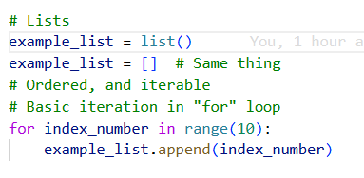
Python Programming
Atomic “Types”
Immutable vs mutable
Strings
Numbers (float, int, complex)
Boolean (bool / True, False)
Built-in types
Lists (arrays in other languages)
Dictionaries (hashmaps)
Sets (unordered lists of unique values)
….many others
Variables
Declared and set simultaneously
Not protected – common developer trap!

Slide 16
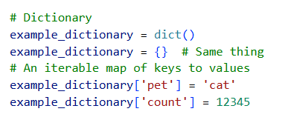
Python Programming
Atomic “Types”
Immutable vs mutable
Strings
Numbers (float, int, complex)
Boolean (bool / True, False)
Built-in types
Lists (arrays in other languages)
Dictionaries (hashmaps)
Sets (unordered lists of unique values)
….many others
Variables
Declared and set simultaneously
Not protected – common developer trap!

Slide 17
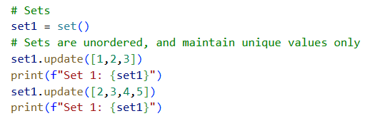
Python Programming
Atomic “Types”
Immutable vs mutable
Strings
Numbers (float, int, complex)
Boolean (bool / True, False)
Built-in types
Lists (arrays in other languages)
Dictionaries (hashmaps)
Sets (unordered lists of unique values)
….many others
Variables
Declared and set simultaneously
Not protected – common developer trap!

Slide 18
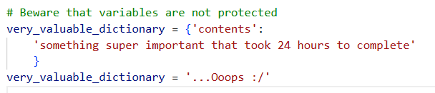
Python Programming
Atomic “Types”
Immutable vs mutable
Strings
Numbers (float, int, complex)
Boolean (bool / True, False)
Built-in types
Lists (arrays in other languages)
Dictionaries (hashmaps)
Sets (unordered lists of unique values)
….many others
Variables
Declared and set simultaneously
Not protected – common developer trap!

Slide 19
Python Programming
Control flow
Provides control of when portions of code are executed
Also provides “Exception handling” – program errors
Equality operators: >, <, ==, !=, >=, <=; “is” and “is not”
System functions & keywords
print
assert
“type”-checking
The “with/open” construct

Slide 20
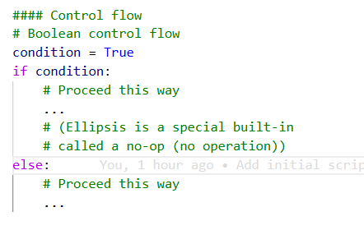
Python Programming
Control flow
Provides control of when portions of code are executed
Also provides “Exception handling” – program errors
Equality operators: >, <, ==, !=, >=, <=; “is” and “is not”
System functions & keywords
print
assert
“type”-checking
The “with/open” construct

Slide 21
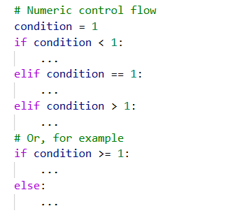
Python Programming
Control flow
Provides control of when portions of code are executed
Also provides “Exception handling” – program errors
Equality operators: >, <, ==, !=, >=, <=; “is” and “is not”
System functions & keywords
print
assert
“type”-checking
The “with/open” construct

Slide 22
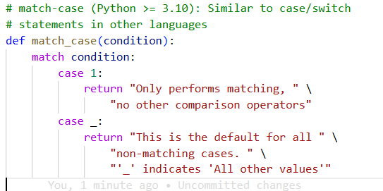
Python Programming
Control flow
Provides control of when portions of code are executed
Also provides “Exception handling” – program errors
Equality operators: >, <, ==, !=, >=, <=; “is” and “is not”
System functions & keywords
print
assert
“type”-checking
The “with/open” construct

Slide 23
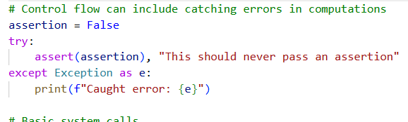
Python Programming
Control flow
Provides control of when portions of code are executed
Also provides “Exception handling” – program errors
Equality operators: >, <, ==, !=, >=, <=; “is” and “is not”
System functions & keywords
print
assert
“type”-checking
The “with/open” construct

Slide 24
Python Programming
Control flow
Provides control of when portions of code are executed
Also provides “Exception handling” – program errors
Equality operators: >, <, ==, !=, >=, <=; “is” and “is not”
System functions & keywords
print
assert
“type”-checking
The “with/open” construct

Slide 25

Python Programming
Control flow
Provides control of when portions of code are executed
Also provides “Exception handling” – program errors
Equality operators: >, <, ==, !=, >=, <=; “is” and “is not”
System functions & keywords
print
assert
“type”-checking
The “with/open” construct

Slide 26

Python Programming
Control flow
Provides control of when portions of code are executed
Also provides “Exception handling” – program errors
Equality operators: >, <, ==, !=, >=, <=; “is” and “is not”
System functions & keywords
print
assert
“type”-checking
The “with/open” construct

Slide 27
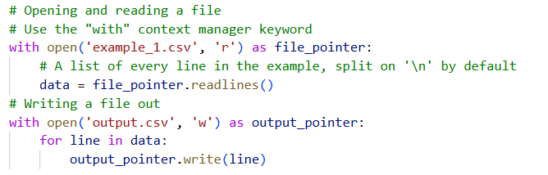
Python Programming
Control flow
Provides control of when portions of code are executed
Also provides “Exception handling” – program errors
Equality operators: >, <, ==, !=, >=, <=; “is” and “is not”
System functions & keywords
print
assert
“type”-checking
The “with/open” construct

Slide 28
Python Programming
Functions
Re-usable code snippets
Arguments
Scope
Stateless*
Objects & classes
Also re-usable
Object is an “instance” of class
Stateful*

Slide 29
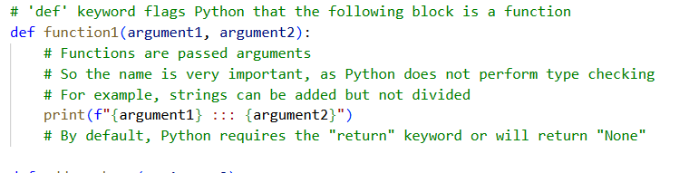
Python Programming
Functions
Re-usable code snippets
Arguments
Scope
Stateless*
Objects & classes
Also re-usable
Object is an “instance” of class
Stateful*

Slide 30

Python Programming
Functions
Re-usable code snippets
Arguments
Scope
Stateless*
Objects & classes
Also re-usable
Object is an “instance” of class
Stateful*

Slide 31
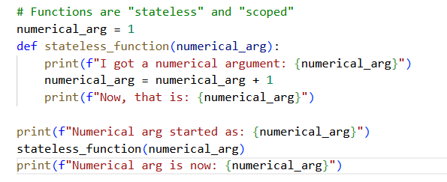
Python Programming
Functions
Re-usable code snippets
Arguments
Scope
Stateless*
Objects & classes
Also re-usable
Object is an “instance” of class
Stateful*

Slide 32
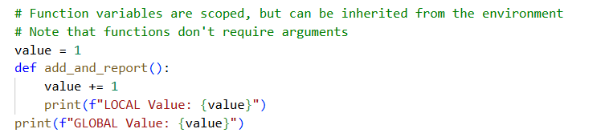
Python Programming
Functions
Re-usable code snippets
Arguments
Scope
Stateless*
Objects & classes
Also re-usable
Object is an “instance” of class
Stateful*

Slide 33
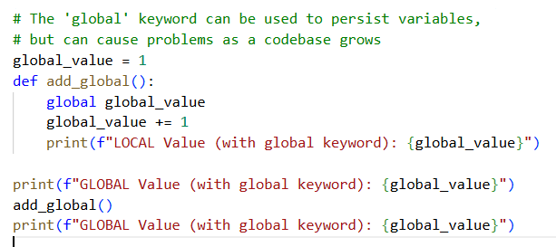
Python Programming
Functions
Re-usable code snippets
Arguments
Scope
Stateless*
Objects & classes
Also re-usable
Object is an “instance” of class
Stateful*

Slide 34
Python Programming
Functions
Re-usable code snippets
Arguments
Scope
Stateless*
Objects & classes
Also re-usable
Object is an “instance” of class
Stateful*

Slide 35
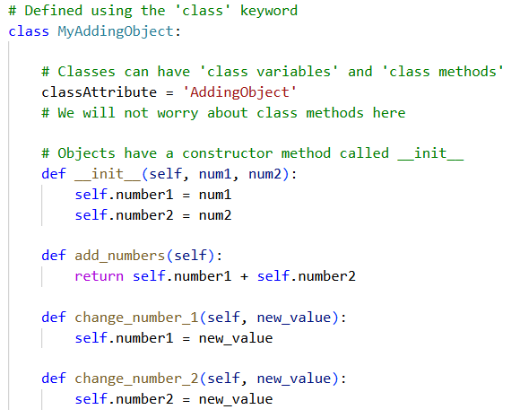
Python Programming
Functions
Re-usable code snippets
Arguments
Scope
Stateless*
Objects & classes
Also re-usable
Object is an “instance” of class
Stateful*

Slide 36
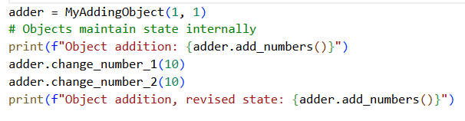
Python Programming
Functions
Re-usable code snippets
Arguments
Scope
Stateless*
Objects & classes
Also re-usable
Object is an “instance” of class
Stateful*

Slide 37
Today’s Outline
Overview of Artificial Intelligence (AI) and Machine Learning (ML)
Data: What are we learning from?
Python programming: Packages
Hands-on: Building a model to make classification predictions

Slide 38
Python Programming and External Packages
Python famously has “batteries included”
But!
Too many packages for distribution in stdlib (Standard Library)
Principal package repository (pypi.org): >715,000 packages available
Packages fill very different use cases
Biomedical data analysis and management (pandas, scipy, numpy, matplotlib, etc.)
Webservers (Django, flask, gunicorn, etc.)
AI & ML (scikit-learn, TensorFlow, PyTorch, etc.)
Database management (sqlite3, MariaDB, PostgreSQL, etc.)
Python package manger is called “pip”
Similar to terminal “apt” (Ubuntu/WSL) and “brew” (Mac)
Only installs Python packages
…A word on virtual environments

Slide 39
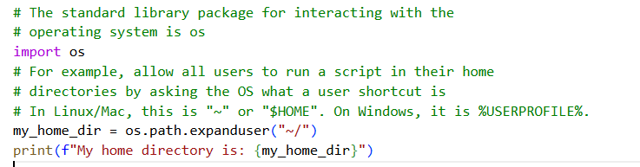
Python Programming and External Packages

Slide 40
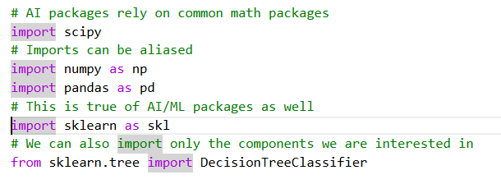
Python Programming and External Packages

Slide 41
Python Programming and External Packages
Python package manger is called “pip”
Similar to terminal “apt” (Ubuntu/WSL), “brew” (Mac), “dnf” (Rocky/RHEL)
Only installs Python packages
…A word on virtual environments

Slide 42
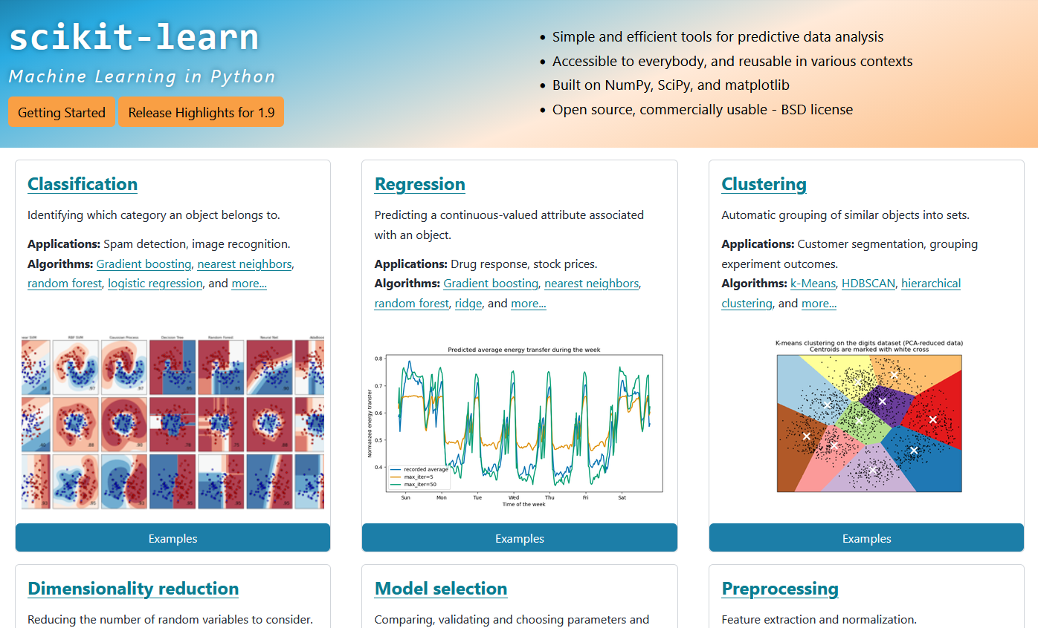
`scikit-learn`
Excellent package for working with all AI/ML models outside of NN
Performant, and (relatively) easy to understand
https://scikit-learn.org/stable/

Slide 43
Today’s Outline
Overview of Artificial Intelligence (AI) and Machine Learning (ML)
Data: What are we learning from?
Python programming
Hands-on: Building a model to make classification predictions

Slide 44
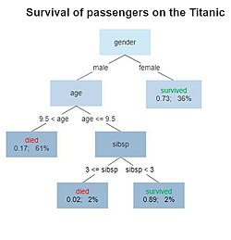
Decision Tree Classifier
Easily reviewed
Derived models (XGBoost, Random Forest, etc.) can be powerful
May lose some interpretability, though
See sklearn…
Wikipedia: Decision Tree

Slide 45
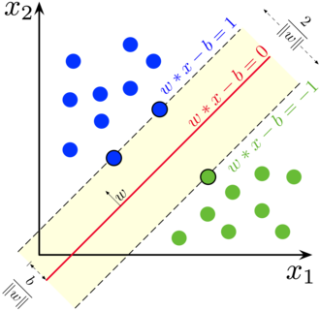
Support Vector Machines (SVMs)
Work by finding maximum separation distance between classes of data
Can be powerful when using “non-linear hyperplanes”
See sklearn…
Wikipedia: SVMs

Slide 46
Attributions
SVMs: By Larhmam - Own work, CC BY-SA 4.0, https://commons.wikimedia.org/w/index.php?curid=73710028
Decision Tree: By Gilgoldm - Own work, CC BY-SA 4.0, https://commons.wikimedia.org/w/index.php?curid=90405437

